Slide 9
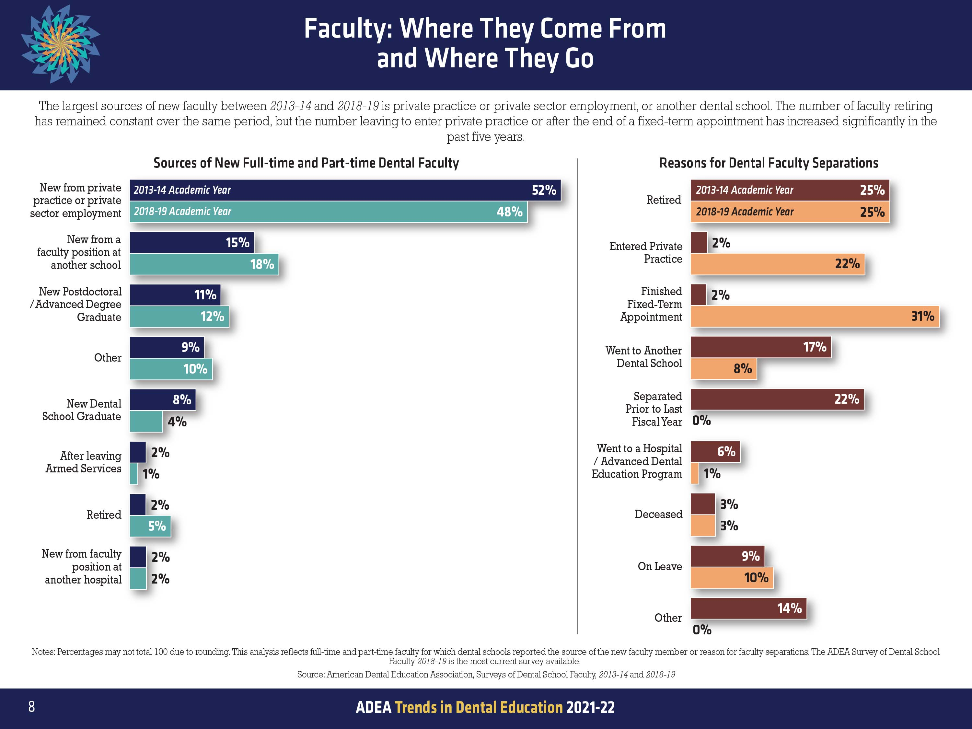

Slide 15
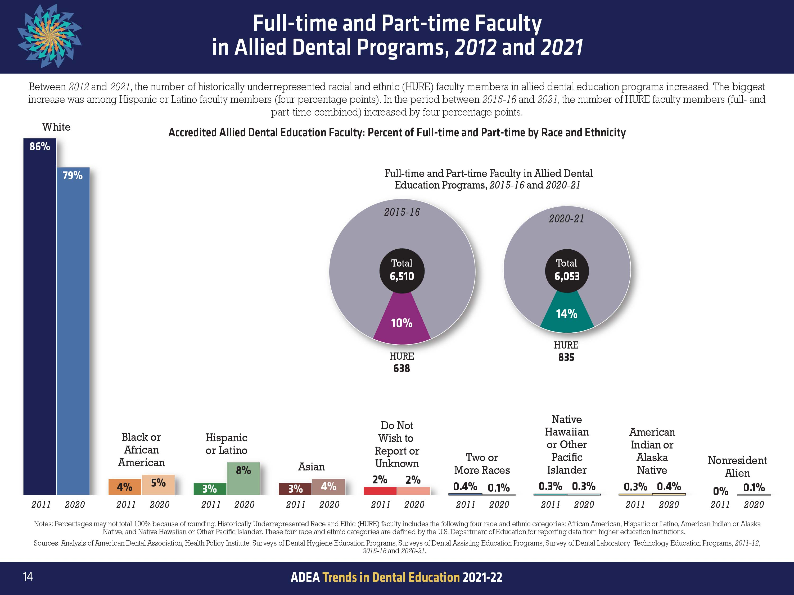

Slide 23
adea.org/DentEdTrends

