Slide 1
ADEA Snapshot of Dental Education
2015-2016

Slide 2
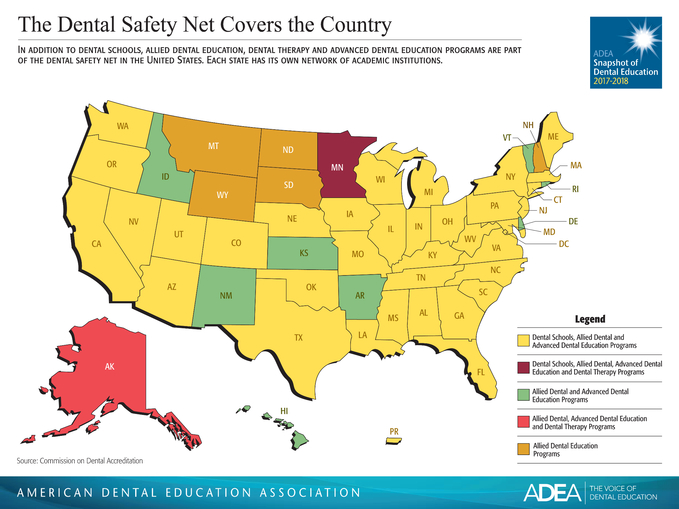

Slide 6
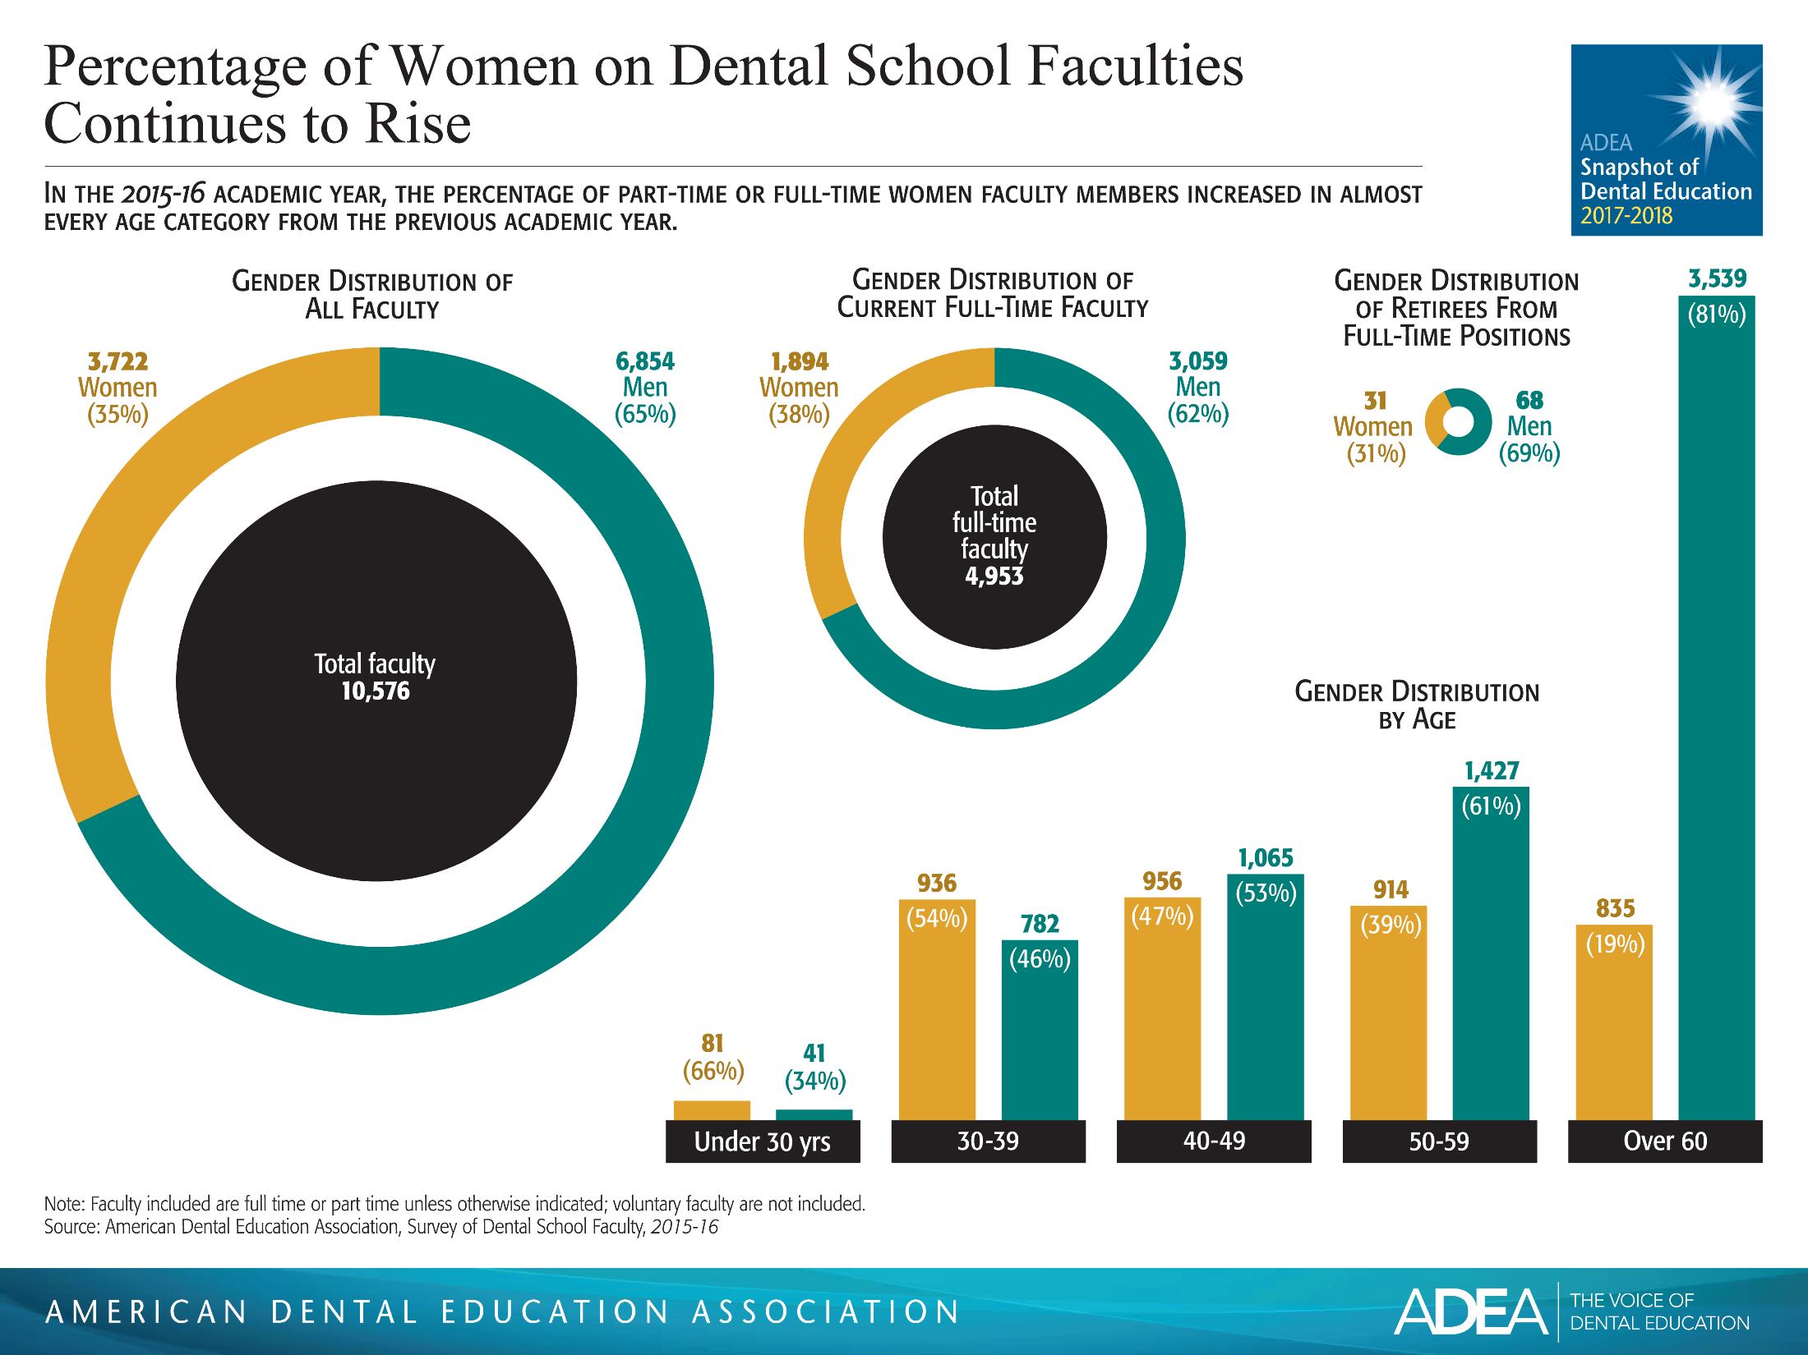

Slide 10
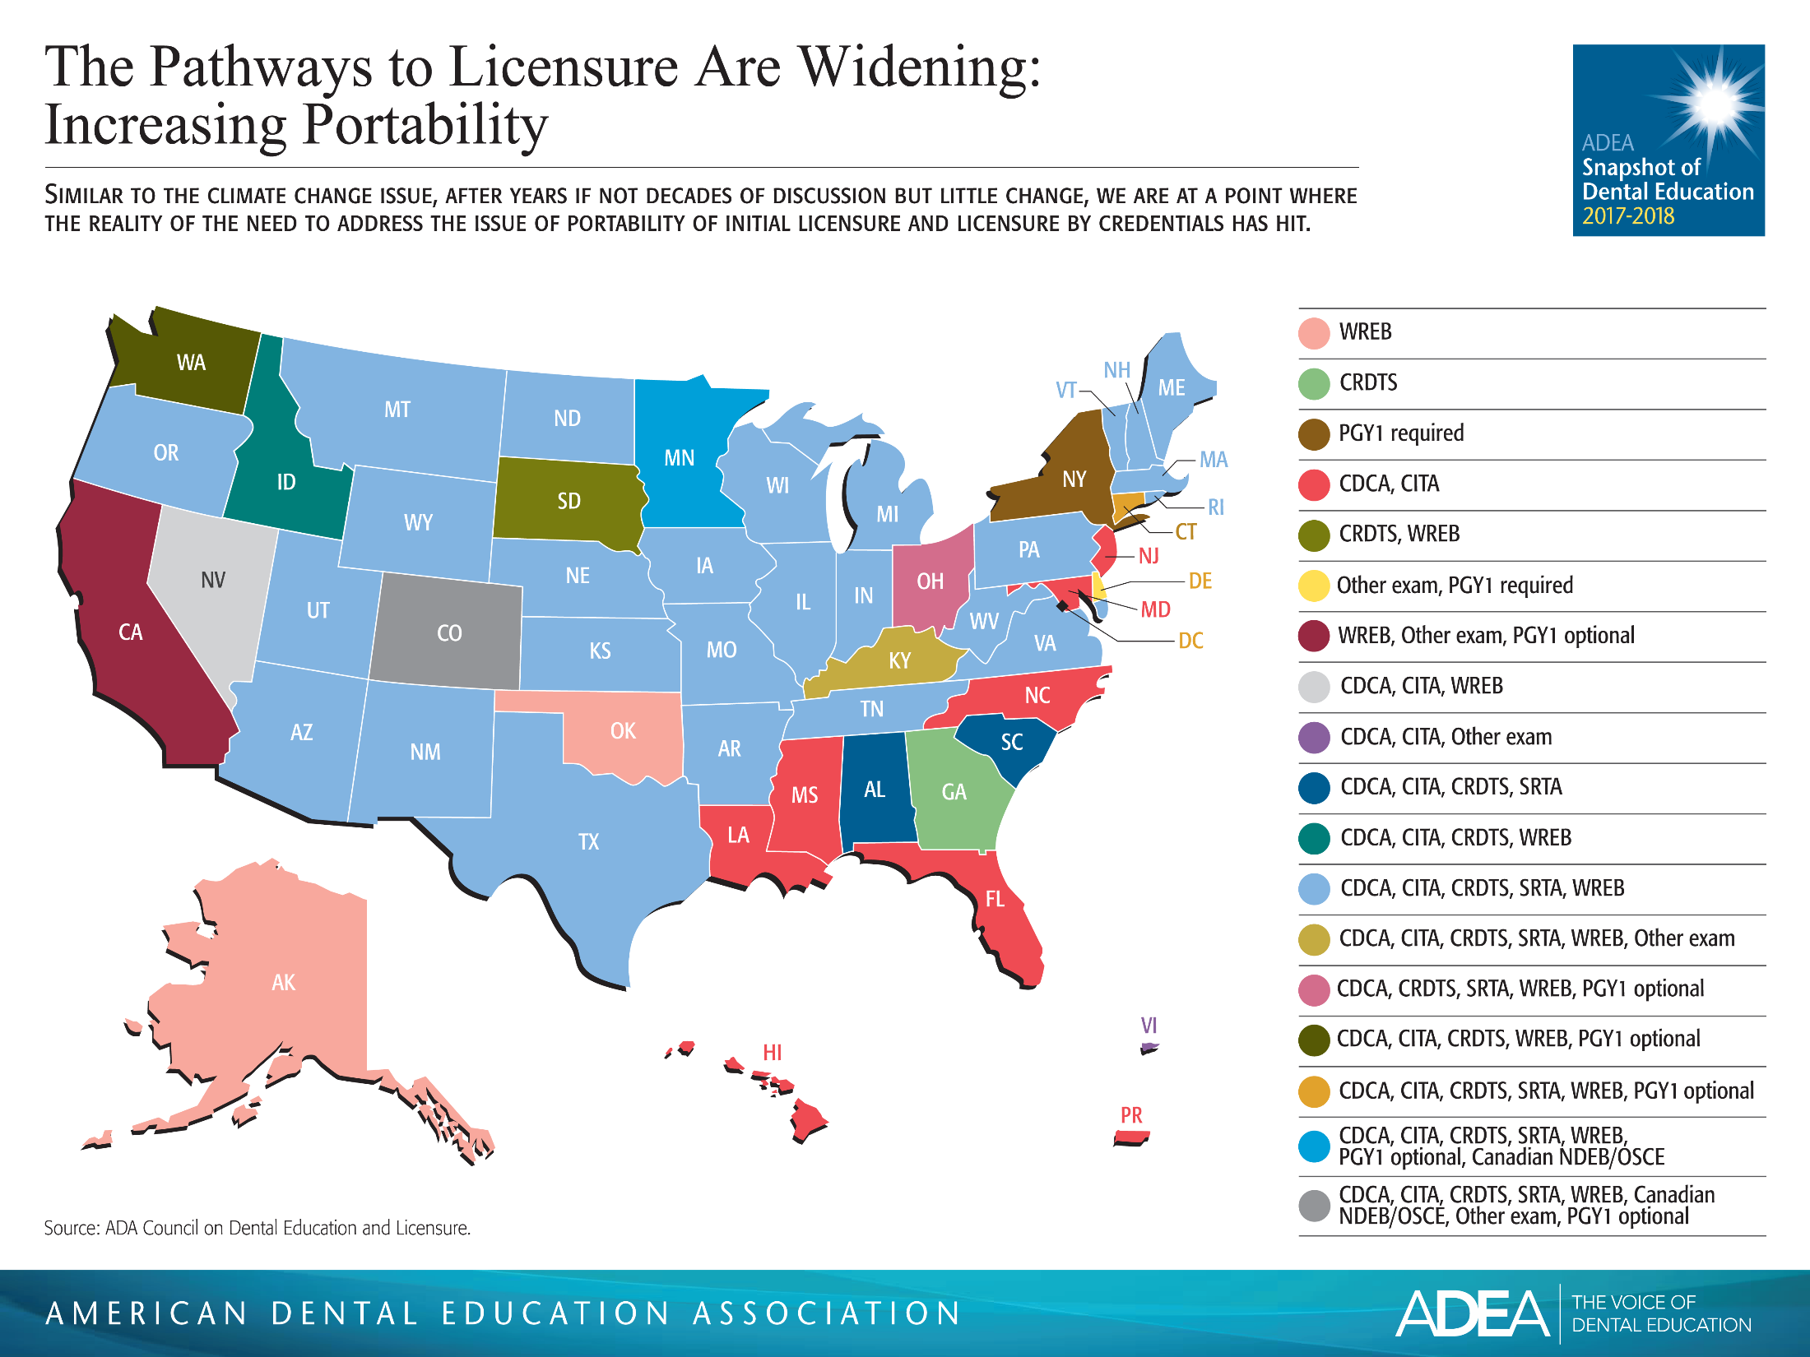

Slide 12
